Slide 1
Part 3
The Wilcoxon rank-sum test

Slide 2
The theory behind the Wilcoxon rank-sum test

Slide 3
Wilcoxon rank-sum test
Step 1: Order the dependent variable from smallest to largest
Group | Frequency
Intervention | 0
Intervention | 3
Intervention | 1
Intervention | 0
Intervention | 2
Control | 2
Control | 31
Control | 29
Control | 30
Control | 5
Group | Frequency
Intervention | 0
Intervention | 0
Intervention | 1
Intervention | 2
Control | 2
Intervention | 3
Control | 5
Control | 29
Control | 30
Control | 31

Slide 4
Wilcoxon rank-sum test
Step 2: Rank the dependent variable from smallest to largest
Assign the lowest value of your dependent variable a rank of 1, the second lowest a rank of 2, etc.
If two are equal, they are ‘tied ranks’. Take the average of the two ranks and make both values equal that.
E.g. Lowest two values are 0:
  Rank 1 and Rank 2.
  Take the average of these (1+2/2) = 1.5

Slide 5
Wilcoxon rank-sum test
Step 2: Rank the dependent variable from smallest to largest
Group | Frequency | Rank
Intervention | 0 | 1.5
Intervention | 0 | 1.5
Intervention | 1 | 3
Intervention | 2 | 4.5
Control | 2 | 4.5
Intervention | 3 | 6
Control | 5 | 7
Control | 29 | 8
Control | 30 | 9
Control | 31 | 10
Rank 1 + Rank 2 (1+2/2) = Both equal 1.5
Rank 4 + Rank 5 (4+5/2) = Both equal 4.5

Slide 6
Wilcoxon rank-sum test
Step 3: Add up the ranks per group
Group | Frequency | Rank
Intervention | 0 | 1.5
Intervention | 0 | 1.5
Intervention | 1 | 3
Intervention | 2 | 4.5
Control | 2 | 4.5
Intervention | 3 | 6
Control | 5 | 7
Control | 29 | 8
Control | 30 | 9
Control | 31 | 10
Intervention: 1.5+1.5+3+4.5+6 = 16.5
Control: 4.5+7+8+9+10 = 38.5
This is referred to as the sum of ranks

Slide 7
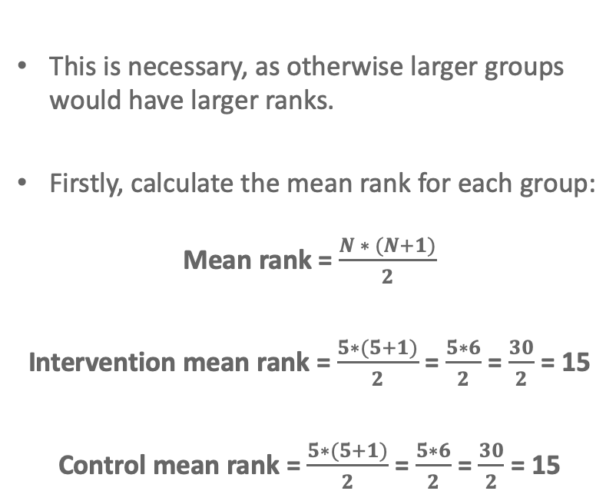
Wilcoxon rank-sum test
Step 4: Correct for the number of people in the group
This is necessary, as otherwise larger groups would have larger ranks.
Firstly, calculate the mean rank for each group:
Mean rank = $\frac{N ∗ (N+1)}{2}$
Intervention mean rank = $\frac{5∗(5+1)}{2}$ = $\frac{5∗6}{2}$ = $\frac{30}{2}$ = 15
Control mean rank = $\frac{5∗(5+1)}{2}$ = $\frac{5∗6}{2}$ = $\frac{30}{2}$ = 15
Group | Frequency | Rank
Intervention | 0 | 1.5
Intervention | 0 | 1.5
Intervention | 1 | 3
Intervention | 2 | 4.5
Control | 2 | 4.5
Intervention | 3 | 6
Control | 5 | 7
Control | 29 | 8
Control | 30 | 9
Control | 31 | 10

Slide 8
Wilcoxon rank-sum test
Step 4: Correct for the number of people in the group
Then minus the mean rank from each group’s sum of ranks:
Sum of ranks – mean rank
Intervention group: 16.5 - 15 = 1.5
Control group: 38.5 – 15 = 23.5
The lowest value is the test statistic (W):
  Intervention group = 1.5

Slide 9
Running the Wilcoxon rank-sum test in R

Slide 10
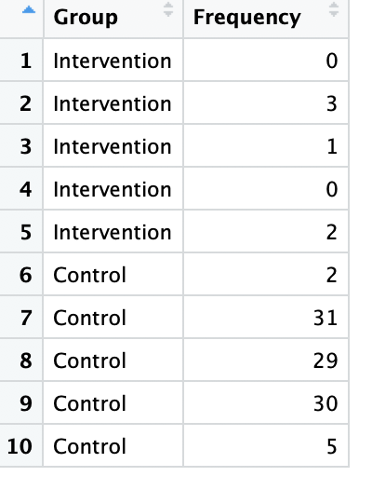
Running a Wilcoxon rank-sum test in R
Import the data
frequency_data dataframe
You do not need to rank the data – R does this for you. Just enter the raw information (i.e. the IV and DV values)

Slide 11
Basic code to run the Wilcoxon rank-sum test
Keep output
DV
Dataframe
Function to run test
Tells R data is not paired (i.e. independent groups design)
IV
Displays the model output

Slide 12

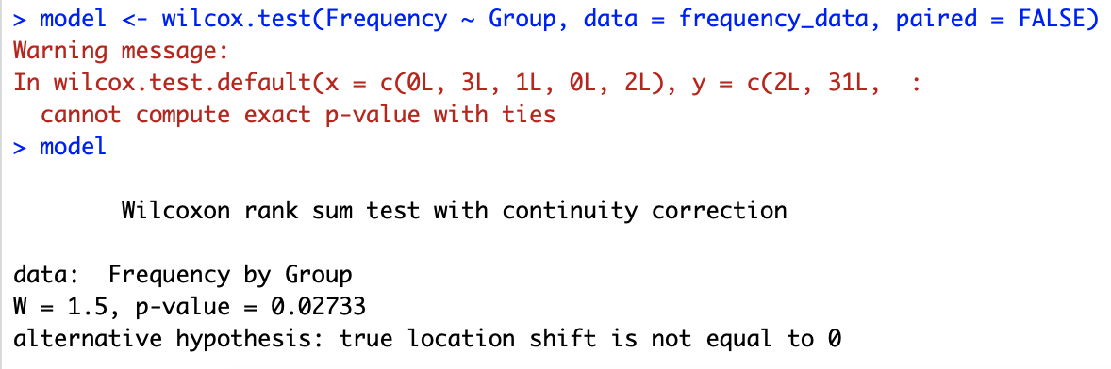

Output for our cigarette example
Same as when we manually calculated W

Slide 13
Output for our cigarette example
There is a significant difference in the number of cigarettes smoked between the intervention and control groups
Is there a significant difference between the groups?
p ≤ .05 = there is a significant difference between the groups
p > .05 = there is no significant difference between the groups

Slide 14
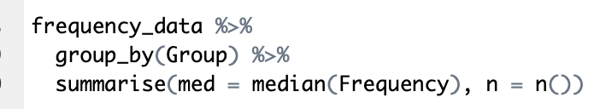
In what direction is our result?
With parametric tests, we typically report the mean. With non-parametric tests, the median is typically preferred.
Name of the independent variable
Produces the descriptive statistics for each group
Dataframe
Instructs R to summarise
Calculate the median frequency and call this ‘med’
How many participants per group? Call this ‘n’
Notes:
The median is a more appropriate measure when the data violates the normality assumption

Slide 15
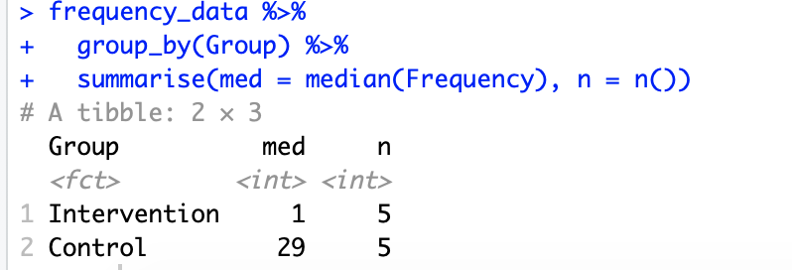
In what direction is our result?
Median number of cigarettes consumed is lower in the intervention group than the control group

Slide 16
Output for our cigarette example
What does this warning message mean? Do I need to worry about it?!

Slide 17
Different ways R calculates the p-value we will cover
The exact method
The normal approximation with continuity correction

Slide 18
1. The exact method
Uses a ”Monte Carlo” method
Creates lots of datasets that are the same as the sample – but instead of assigning the correct group, assigns group randomly
Group | Frequency | Rank
Control | 0 | 1.5
Intervention | 0 | 1.5
Intervention | 2 | 3.5
Control | 2 | 3.5
Intervention | 4 | 5
Intervention | 7 | 6
Control | 14 | 7.5
Control | 14 | 7.5
Control | 15 | 9
Intervention | 16 | 10
Group | Frequency | Rank
Intervention | 0 | 1.5
Intervention | 0 | 1.5
Intervention | 2 | 3.5
Intervention | 2 | 3.5
Control | 4 | 5
Intervention | 7 | 6
Control | 14 | 7.5
Control | 14 | 7.5
Control | 15 | 9
Control | 16 | 10
Group | Frequency | Rank
Intervention | 0 | 1.5
Intervention | 0 | 1.5
Intervention | 2 | 3.5
Control | 2 | 3.5
Control | 4 | 5
Control | 7 | 6
Control | 14 | 7.5
Control | 14 | 7.5
Intervention | 15 | 9
Intervention | 16 | 10
x1000s of times

Slide 19
1. The exact method
In these datasets, we know the null hypothesis is true (there is no difference between groups because we have randomly assigned group)
How often is the difference that appears in the generated datasets (blue) as large as the difference in the true data (red and green)?
Group | Frequency | Rank
Control | 0 | 1.5
Intervention | 0 | 1.5
Intervention | 2 | 3.5
Control | 2 | 3.5
Intervention | 4 | 5
Intervention | 7 | 6
Control | 14 | 7.5
Control | 14 | 7.5
Control | 15 | 9
Intervention | 16 | 10
Group | Frequency | Rank
Intervention | 0 | 1.5
Intervention | 0 | 1.5
Intervention | 1 | 3
Intervention | 2 | 4.5
Control | 2 | 4.5
Intervention | 3 | 6
Control | 5 | 7
Control | 29 | 8.5
Control | 30 | 8.5
Control | 31 | 10
Group | Frequency | Rank
Intervention | 0 | 1.5
Intervention | 0 | 1.5
Intervention | 2 | 3.5
Intervention | 2 | 3.5
Control | 4 | 5
Intervention | 7 | 6
Control | 14 | 7.5
Control | 14 | 7.5
Control | 15 | 9
Control | 16 | 10
Group | Frequency | Rank
Intervention | 0 | 1.5
Intervention | 0 | 1.5
Intervention | 2 | 3.5
Control | 2 | 3.5
Control | 4 | 5
Control | 7 | 6
Control | 14 | 7.5
Control | 14 | 7.5
Intervention | 15 | 9
Intervention | 16 | 10
x1000s of times

Slide 20
2. The normal approximation with continuity correction
Assumes that the sampling distribution of the W statistic is normal
  This produced a standard error
  → This can be used to calculate z (and then a p-value)
By default, it applies a continuity correction
  → This corrects for the fact we are assuming the sampling distribution of W is normal, but a person can change in ranks only in set amounts (e.g. 1, or 0.5 if tied ranks)
Don’t worry if you don’t fully understand this. The key is to understand there are two different methods for how the p-value is calculated

Slide 21
Which is the default method?
It depends…
Sample size < 50 in all group and no tied ranks = exact method
Sample size ≥ 50 in any group OR tied ranks = normal approximation with continuity correction
Note: you can also specify which method should be run,
but we won’t cover that in this set of lectures

Slide 22
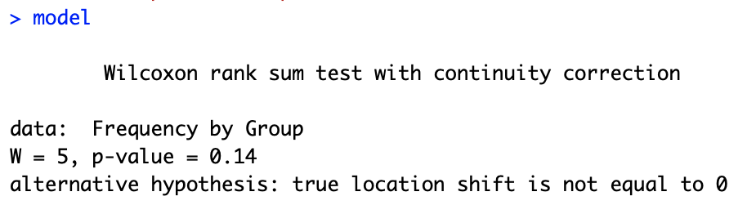
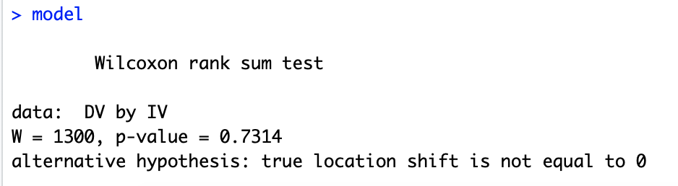
How do I know which method R has used?
Normal approximation with continuity correction
The exact method

Slide 23
Output for our smoking example
This warning message just tells you that it tried to do the exact method (because <50 participants per group), but couldn’t be completed due to tied ranks
The p-value in our smoking example was calculated using the normal approximation with continuity correction

Slide 24

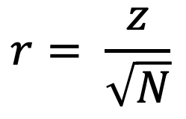
What about an effect size?
Not provided, but it can be estimated using the R output
Can be calculated from the p-value by running the following code:
$$r= \frac{z}{\sqrt{N}}$$
Total number of observations in the study

Slide 25
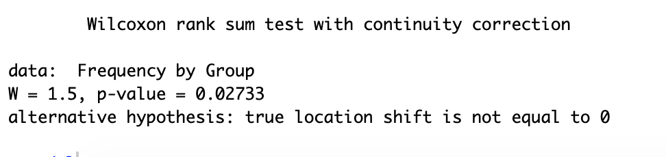

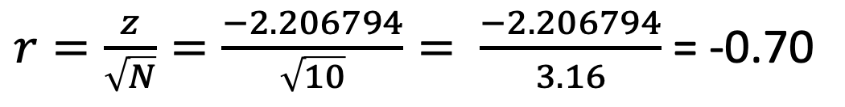
Our smoking example
$r=\frac{z}{\sqrt{N}}=\frac{−2.206794}{\sqrt{10}}= \frac{−2.206794}{3.16}$ = -0.70

Slide 26
How do we interpret the effect size?
Interpretation
 | Positive | Negative
Small | 0.1 to 0.3 | -0.1 to -0.3
Medium | 0.3 to 0.5 | -0.3 to -0.5
Large | 0.5 to 1.00 | -0.5 to -1.00
In our example, r = -0.70.
Large effect size

Slide 27
Reporting the results in APA format
A Wilcoxon rank-sum test revealed that the number of cigarettes smoked was significantly lower in the intervention group (Median = 1; Range = 0-3) relative to the Control group (Median = 29; Range = 2-31), W = 1.5, p = .027, r = -.70.

Slide 28
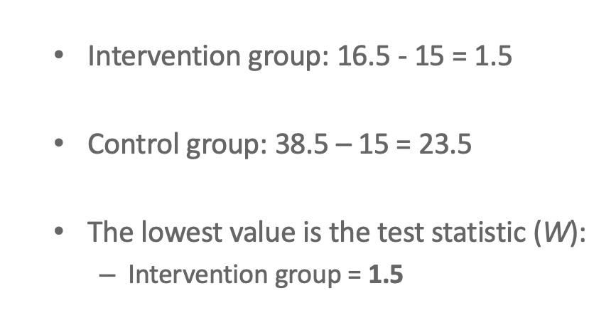
Wait…
Why is my W different when calculated manually and in R?
If you were to calculate W manually, W should be the smallest value (sum of ranks – mean rank)
In R, W is reported for the first factor level
Doesn’t affect significance, so not something you need to worry about
  → You can just report what R outputs
Calculating manually – W = 1.5
Reported by R – W = 1.5 OR 23.5

